Slide 1
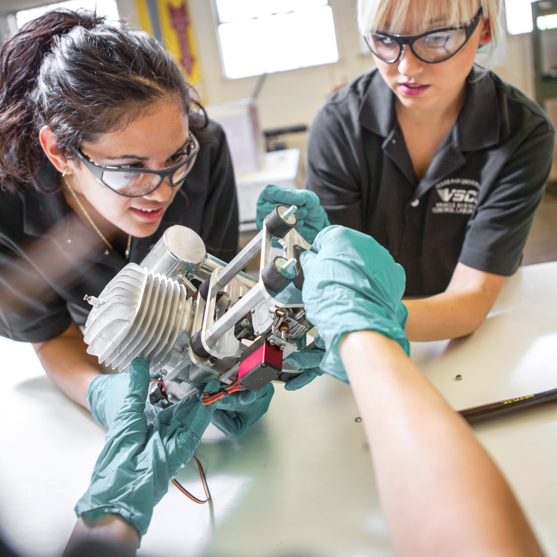

Cloud Computing: a quick introduction
Dilma Da Silva
Professor & Department Head
Computer Science & Engineering
Texas A&M University

Slide 2


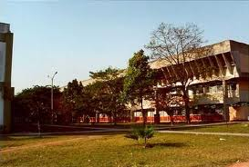

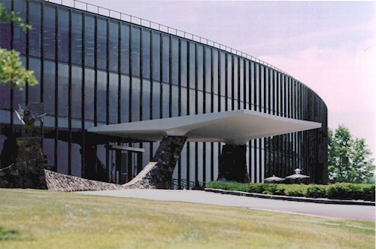

Learning Places

Slide 3
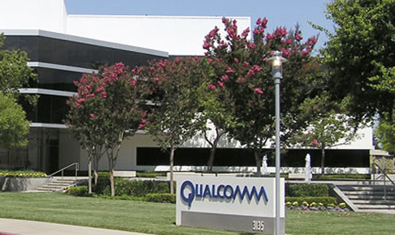
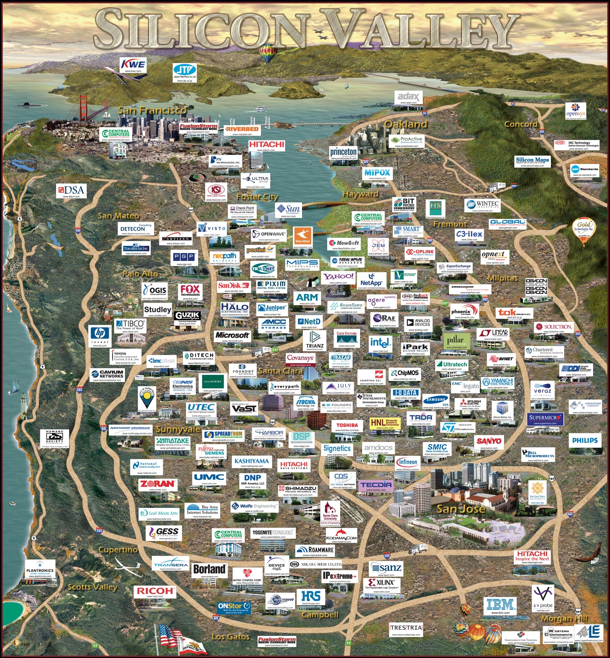
Learning Places

Slide 4

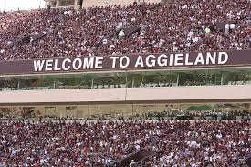
Learning Places

Slide 5

Did you use the cloud today?
Notes:
Did you cloud today? What goes on inside the cloud to make it work? To make it profitable?

Slide 6
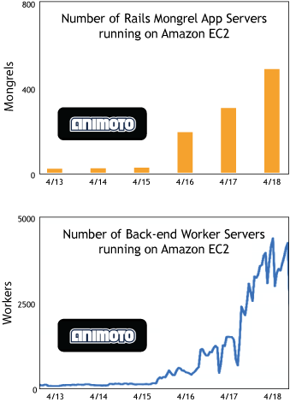
Canonical 2008 picture: motivation for cloud-based approach

Slide 7
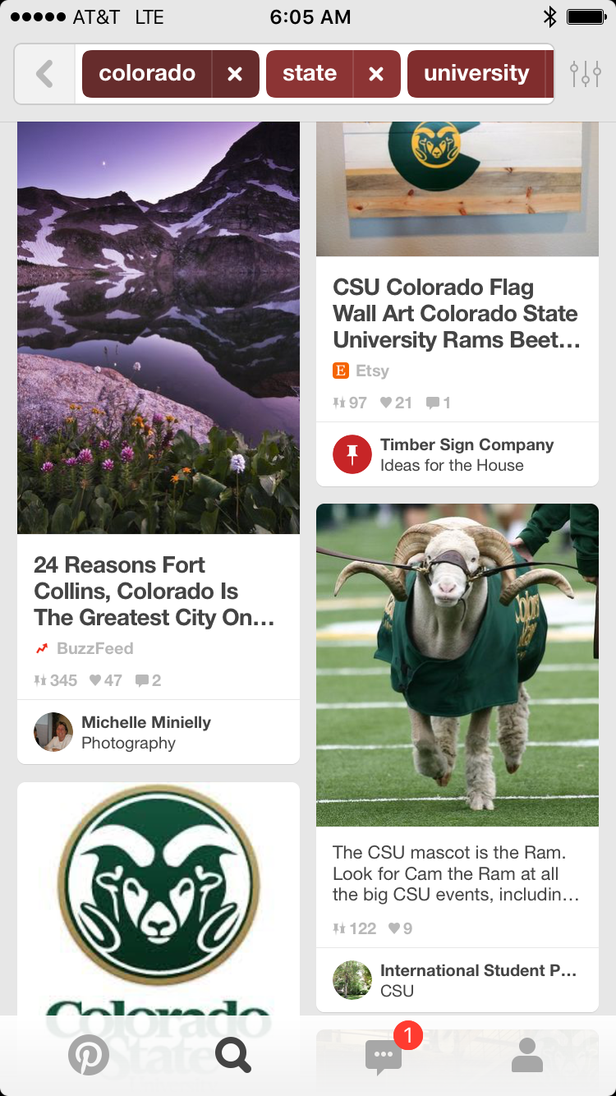
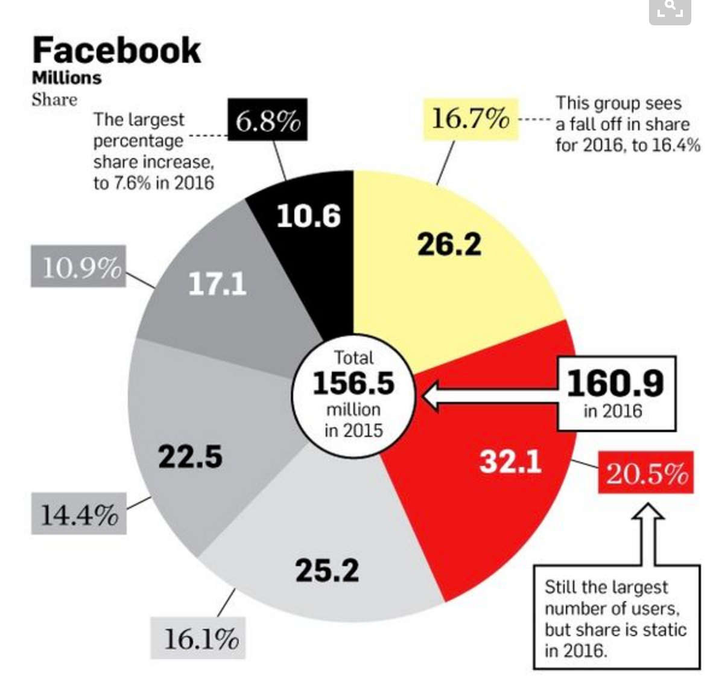
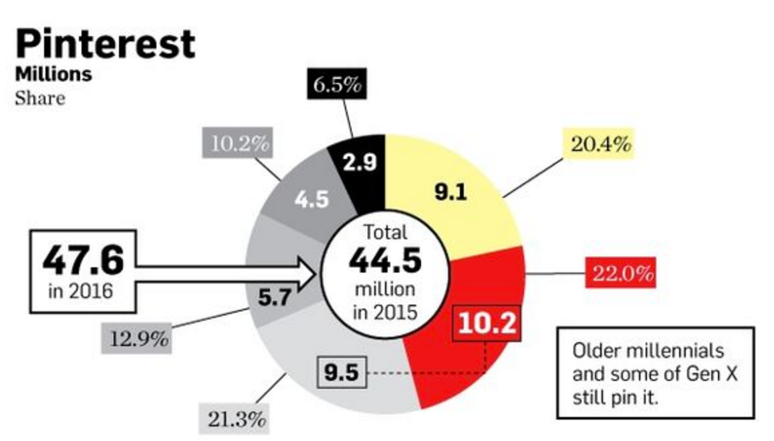
Pinterest
Number of users doubled since 2012
Notes:
Every start up dream: grow faster than facebook/twitter without a farm of servers
Born in 2010, usage doubles since 2012
80% of users are women -> as of Feb/16, 33% men
75% traffic from mobile, 35% users mobile only
RELEVANCE INCREASING: 93% pinners shopped online in the past 6 months; Pin with prices get 36% likes, forecasting $169 million revenue
Wall Street Journal says as of 3/15/15, valued 11 billion
140 employees as of oct/13, now listed as 500+
Sources; http://sproutsocial.com/insights/pinterest-statistics/
https://www.pinterest.com/wglvsocialmedia/pinterest-statistics-facts-figures-rules/
https://www.pinterest.com/pin/30751209933620844/
http://www.wsj.com/articles/pinterest-raises-367-million-at-11-billion-valuation-1426538379

Slide 8
Pinterest
Number of users doubled since 2012
Growth without owning any servers! for a long time only 1 operation engineer
Notes:
Every start up dream: grow faster than facebook/twitter without a farm of servers
Born in 2010, usage doubles since 2012
80% of users are women -> as of Feb/16, 33% men
75% traffic from mobile, 35% users mobile only
RELEVANCE INCREASING: 93% pinners shopped online in the past 6 months; Pin with prices get 36% likes, forecasting $169 million revenue
Wall Street Journal says as of 3/15/15, valued 11 billion
140 employees as of oct/13, now listed as 500+
Sources; http://sproutsocial.com/insights/pinterest-statistics/
https://www.pinterest.com/wglvsocialmedia/pinterest-statistics-facts-figures-rules/
https://www.pinterest.com/pin/30751209933620844/
http://www.wsj.com/articles/pinterest-raises-367-million-at-11-billion-valuation-1426538379

Slide 9
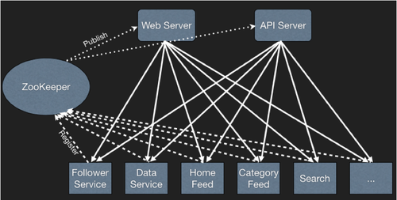
Pinterest architecture
Notes:
https://engineering.pinterest.com/blog/zookeeper-resilience-pinterest
https://engineering.pinterest.com/blog/discover-pinterest-cloud-engineering
https://www.youtube.com/watch?v=Enxd6U7zrJc

Slide 10
application architecture is standard
Web Application Servers
Internal Web Servers
Cache Server
Sharded Database
File Storage

Slide 11
With numbers from 2013
Web ApplicationServers
(150 High-CPU instances running python Django)
Elastic Load Balancer
Internal Web Servers (35 for other pinterest; 60 for auxiliary e.g. logging)
Cache Server (90 High Memory instances)
Elastic Map
Reduce
Sharded Database
(MySQL database: 70 masters nodes+70 slaves on other zone)
File Storage (8 billiion objects 410TB)
Notes:
It started with 8 master-slaves pairs, now 64 (not query goes through multiple shards)

Slide 12
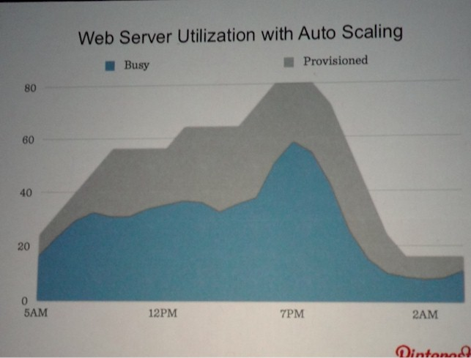
Auto-scaling in action

Slide 13
Cloud essential (or usual) characteristics
Agility through elastic, on-demand resources that scale up and down
Self-service, automated APIs
A menu of “server” options
Availability zones
Pay as-you-go
Shift $ from capital to expenses
Economy of scale
Notes:
What is research in this context?
improve cloud provider services: essentially better resource usage (what is new?), but also resilience and security

Slide 14
Enabling forces: Virtualization and IT commoditization

Slide 15
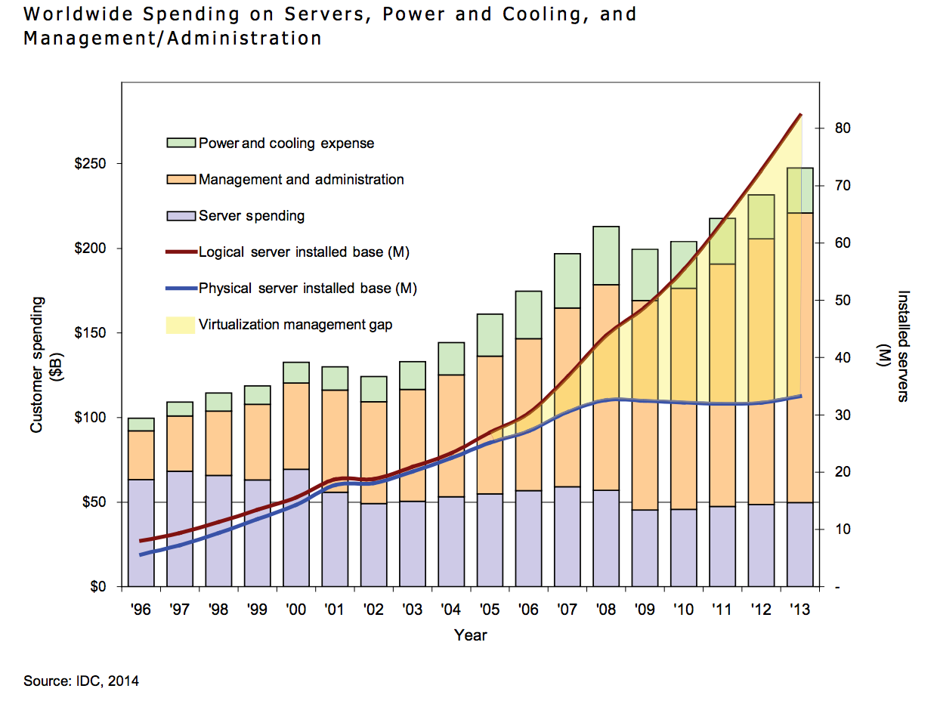
Notes:
http://www.lenovo.com/images/products/server/pdfs/whitepapers/IDC%20Whitepaper%20246755.pdf

Slide 16
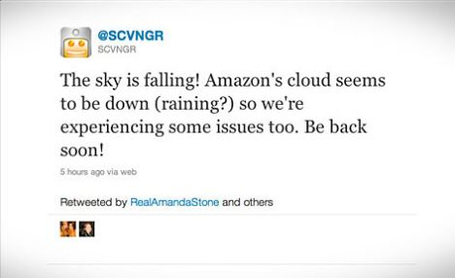
Sometimes things don’t go well

Slide 17
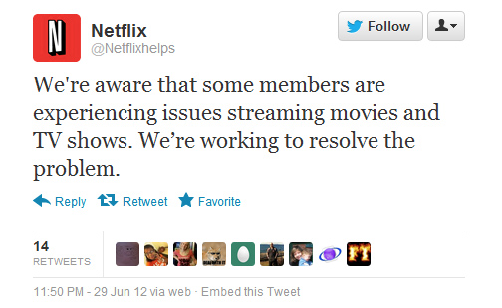
Sometimes things don’t go well

Slide 18
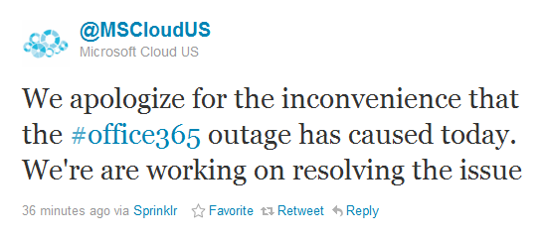
Sometimes things don’t go well

Slide 19
Research topics
datacenter challenges
efficiency (hardware, people, facilities)
security
resilience
problem determination
software engineering challenges
elasticity support in the application
workload deployment

Slide 20
My cloud innovation story
what is cloud about? [IEEE GCE’08]
implemented IBM first cloud [USENIX LISA 2010]
memory over-commitment [IEEE CloudCom 2011]
performance isolation [SMTPS’12]
optically-connected memory [IPDPS’12]
flexible groups [ICDCS’12]
benchmarking [Winter Simulation’12, IEEE IC2E’13]
SPEC
openstack resilience [ACM SOCC’13]
Notes:
IEEE Grid Computing Environments (much before Berkeley white paper on cloud)

Slide 21

Thank you!

